Slide 1
What are some challenges facing the world?
What kind of world do you want to see in 20 years for your kids?
Who is working on solutions to the world’s challenges?
What do your students know about the world?
What are the skills students need to succeed in school or work?
What tools do we have to help students learn about the world?
What is digital literacy?
What is global competence?
Are global issues local?
Can students take actions to address global issues?
How is the US population changing?
Notes:
Use these ten questions as a hook. Hand out to participants. In groups let them discuss answers. Ask for groups to share their answers. Then begin presentation.

Slide 2
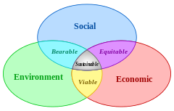
21st century education
means
Global competence
Model of Sustainability
Community and Global Studies Academy
Notes:
Activity: Pass out questions and let small groups answer.
We, and our children and grandchildren want to live in a sustainable world. The alternative is the collapse of our society and one of the many dystopian futures science fiction authors have dreamt up over the last 100 years.
The model of sustainability has three components: Environmental, economic and social. In today's world; sustainability must be global; you can’t escape the challenges by not thinking globally.

Slide 3
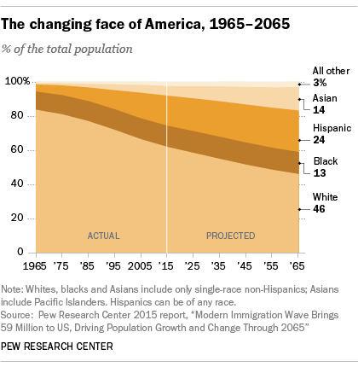
The U.S. is changing and we have to be ready
Americans are more racially and ethnically diverse than in the past, and the U.S. is projected to be even more diverse in the coming decades. By 2055, the U.S. will not have a single racial or ethnic majority.
Asia has replaced Latin America (including Mexico) as the biggest source of new immigrants to the U.S.
In the United States, Christians will decline from more than three-quarters of the population in 2010 to two-thirds in 2050, and Judaism will no longer be the largest non-Christian religion. Muslims will be more numerous in the U.S. than people who identify as Jewish on the basis of religion
Notes:
Even if you try to just isolate yourself, like a global gated community, the world is coming here and interacting with people of different cultures, languages and religions is inevitable. We have to prepare our kids.

Slide 4
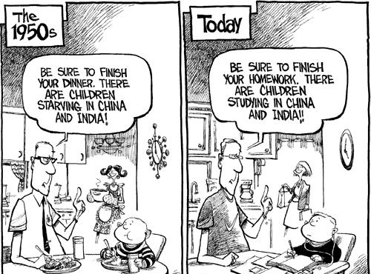
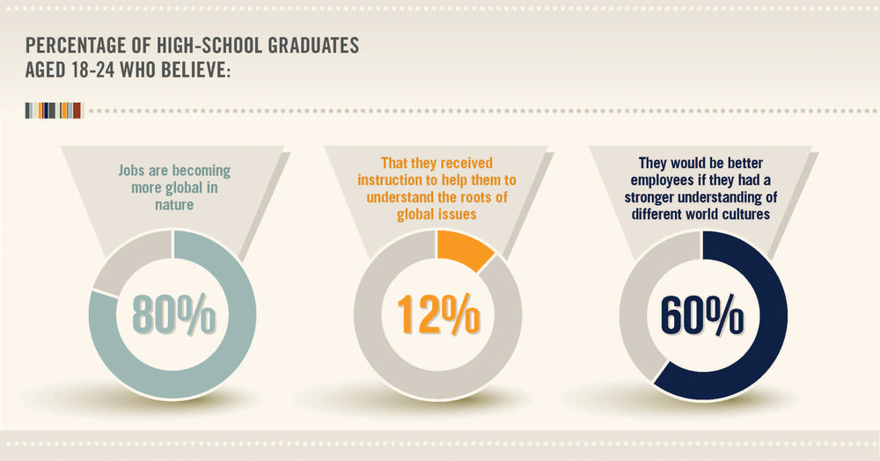
The Economic necessity
Eighty percent of 800 U.S. executives agree that their businesses would increase if staff had international experience.The majority…. believe that international skills are required at both the management and entry levels.
An Association of American Colleges and Universities study found that 97 percent of business executives identified intercultural skills, or being “comfortable working with colleagues, customers, and/or clients from diverse cultural backgrounds,” as important.
A study on soft skills conducted in more than 100 countries by the British Council, IPSOS Public Affairs, and Booz|Allen| Hamilton found that employers increasingly need employees who “are not only technically proficient but also culturally astute and able to thrive in a global work environment.”
Notes:
First is economic globalization. Jobs of the future require global competence.

Slide 5
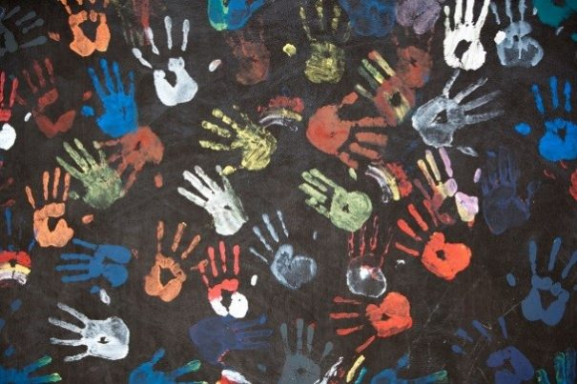
The Social need
I mean an order built on three simple ideas, the idea that all people have the same rights, the idea that freedom is preferable to un-freedom and the idea that, as members of the same species, we are bound together in our obligation to advance these rights across national borders, and that we should collaborate peacefully in addressing our shared challenges.
-Fernando Reimers
Notes:
Ben Franklin said, “We must, indeed, all hang together or, most assuredly, we shall all hang separately.” we will shape the future world. What will it look like?

Slide 6
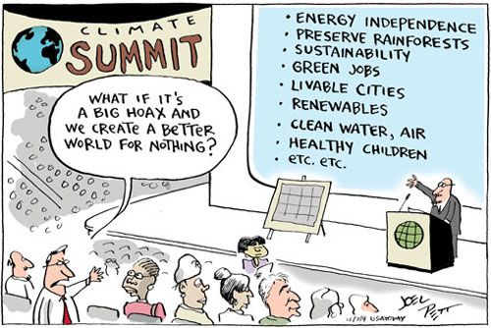
The Environmental Imperative
Climate change is the defining issue of our time. Responding to it effectively is essential for sustainable development. Climate change is intrinsically linked to public health, food and water security, migration, peace and security.
-Ban Ki-moon
Notes:
If we don’t care for the global environmental problems of arable land, potable water and a livable climate, the planet will shake us off, like a bad case of fleas.

Slide 7
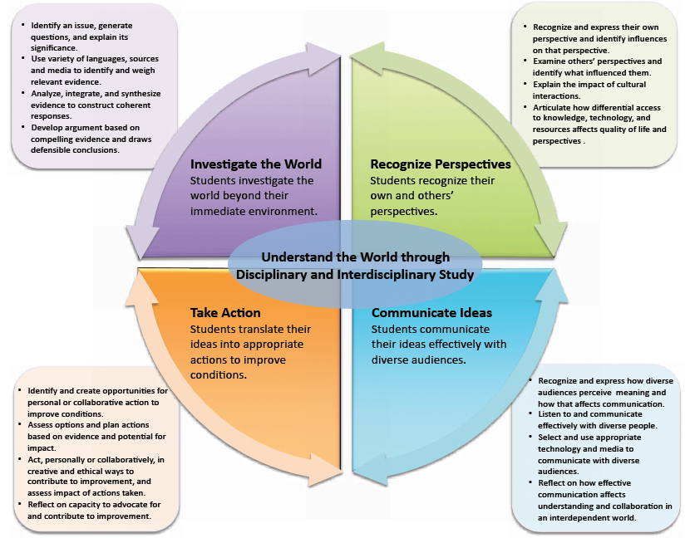
Global Competency
Notes:
What it means to educate a globally competent student.

Slide 8
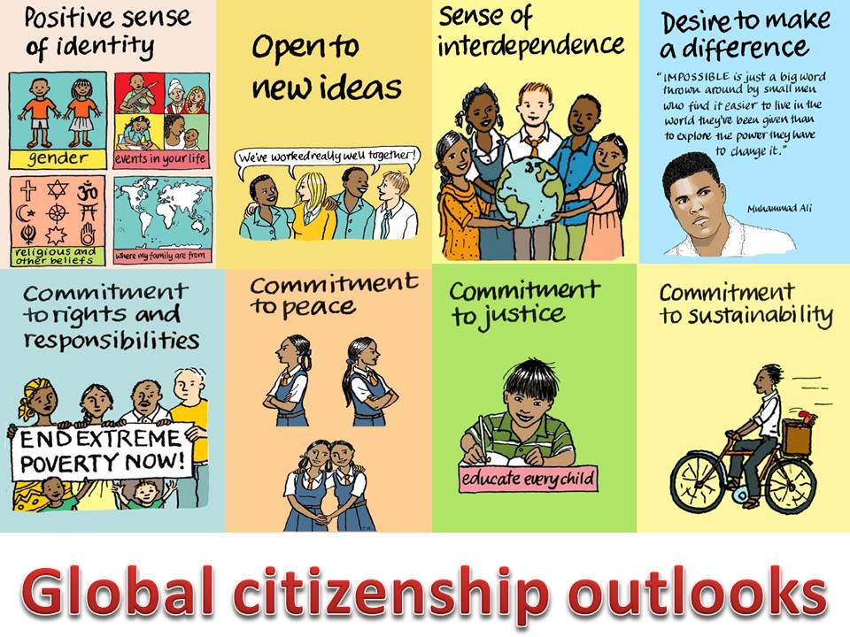

Slide 9
We are not alone- and we are making progress
Notes:
The number of children dying has been cut in half from 12 to 6 million. Still too many Global extreme poverty also cut in half. We can do more.

Slide 10
Glocal paradigm
Think Global, act local.- Solutions to global problems are a million local solutions.
Notes:
Make sure our students act! Local NGO’s?

Slide 11
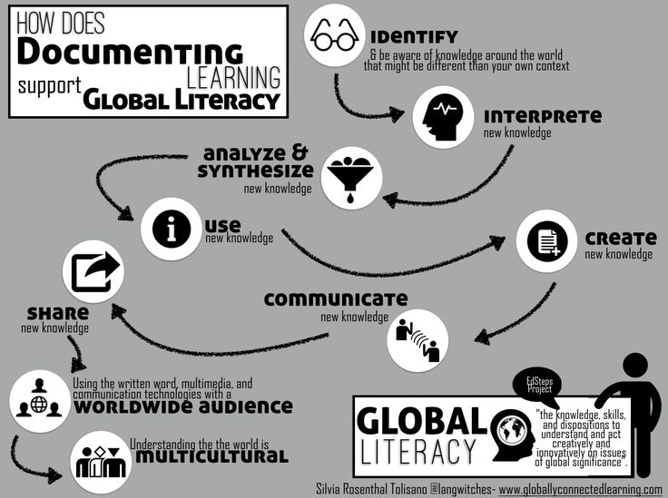
Notes:
Students need to digital tools and they need to know how to use them.

Slide 12
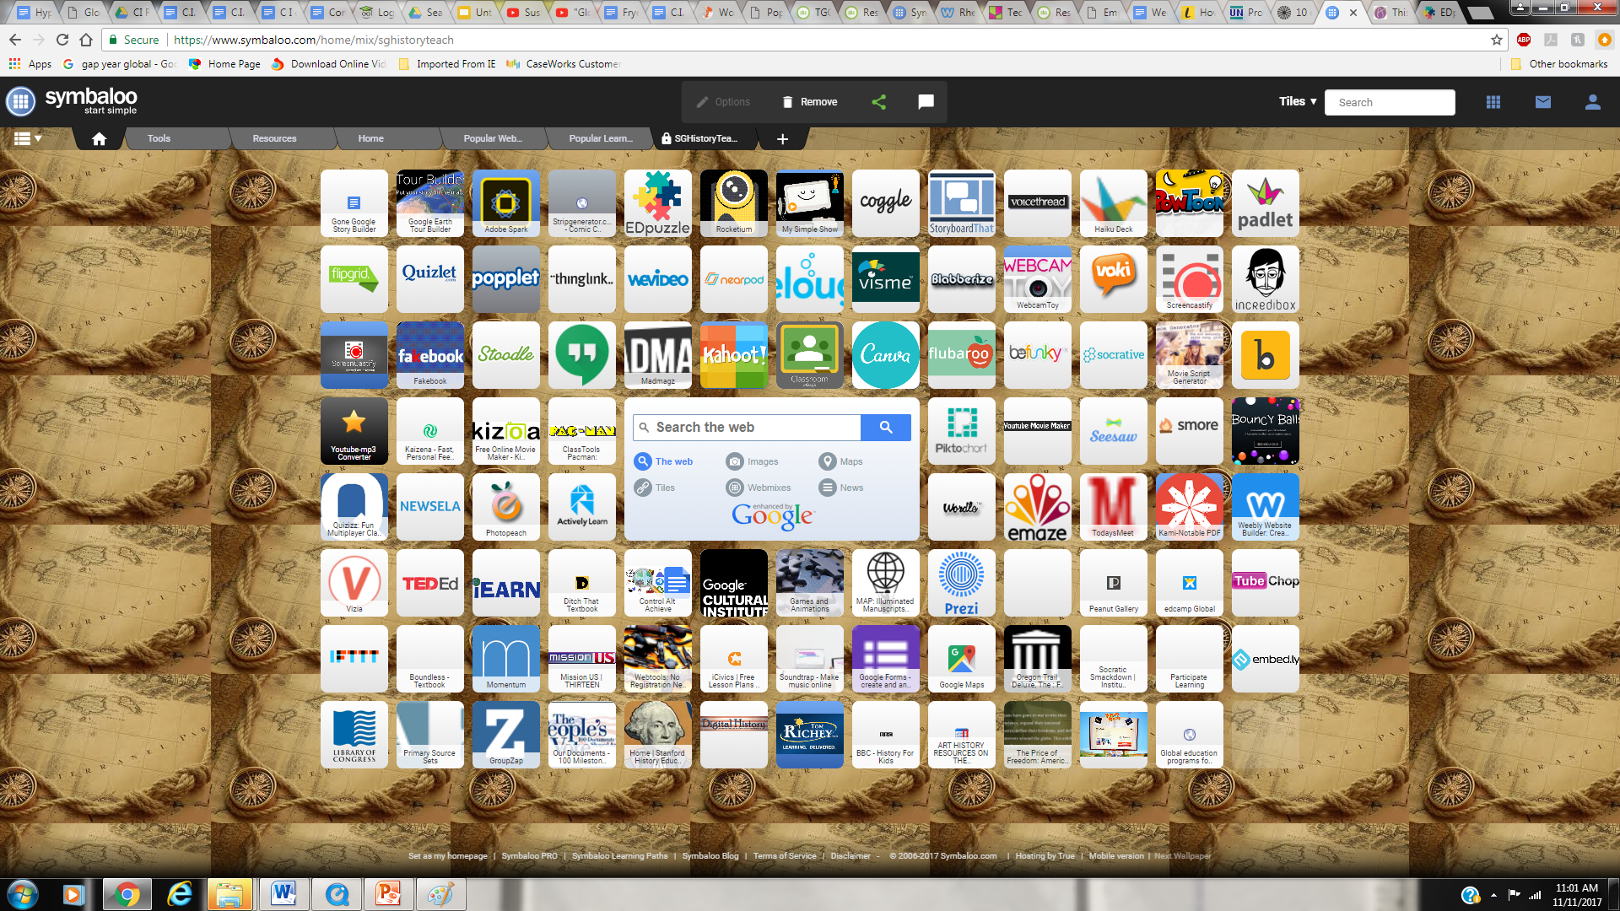
Tools for Digital Literacy for teachers
Notes:
Rhett- Just a few ideas to play with to help our students become digitally literate, communicate across cultures, and for us to be 21st century educators.

Slide 13
For students
https://www.nature.org/about-us/careers/leaf/index.htm
https://www.thesca.org/serve/national-crews
http://www.nsliforyouth.org/
http://www.usagermanyscholarship.org/apply-afs/
http://www.yes-abroad.org/
https://www.japansociety.org/page/programs/education_family/programs_for_students/japan-society-junior-fellows-program
Notes:
For students who want first hand experience.

Slide 14
Next steps?
1.Spend time looking at available resources. (see next page)
2. Incorporate technology into your unit. (play with the tools a couple pages back)
3.If you teach literacy, look at texts used in your curriculum and think about how you can incorporate a more culturally diverse text. Plenty of suggestions on Primary Source (on resources page) .
4.Read one of the following texts on global education that will give you more insight into why it matters.
•That Used To Be Us, by Thomas Friedman
•Creating Innovators, by Tony Wagner
•World Class Learners, by Yong Zhao
5.Take a lesson plan or part of your unit and see how you can incorporate a global focus.
For example: In math class use graphs or story problems with examples from global issues.
6.Start to expose students to news about global issues, especially the international press and have them reflect.
7. Go Glocal! Look for examples of global issues locally
8. See me for suggestions on ways to globalize your lessons

Slide 15
Resources
https://asiasociety.org/files/book-globalcompetence.pdf
http://www.oxfam.org.uk/education/who-we-are/global-citizenship-guides
https://docs.google.com/document/d/10SxK7SiF8DBiWMwi3Bsq6j-FT_xc6ehuId1fx8tUsZ0/edit
http://www.nccap.net/media/pages/Global%20Education%20Checklist1.pdf
https://docs.google.com/document/d/1d03Qq6-Jt4BTcEcM6duGtbFBxXaZ4uOOzihNv7IJwmU/edit

Slide 16
Sources
For technology- Mr Rhett Oldham - Tech Guru. Ste. Genevieve Middle School
http://www.pewresearch.org/fact-tank/2016/03/31/10-demographic-trends-that-are-shaping-the-u-s-and-the-world/
https://www.un.org/press/en/2015/sgsm16710.doc.htm
https://www.un.org/press/en/2015/sgsm16710.doc.htm
http://asiasociety.org/education/global-competence
https://www.youtube.com/watch?v=UTE0G9amZNk

